Slide 1
Wireless LAN Technology - Introduction
Chapter 8

Slide 2
Wireless LAN Applications
LAN Extension
Cross-building interconnect
Ad hoc networking

Slide 3
LAN Extension
Wireless LAN linked into a wired LAN on same premises
  Wired LAN
    Backbone
    Support servers and stationary workstations
  Wireless LAN
    Stations in large open areas
    Manufacturing plants, stock exchange trading floors, and warehouses

Slide 4
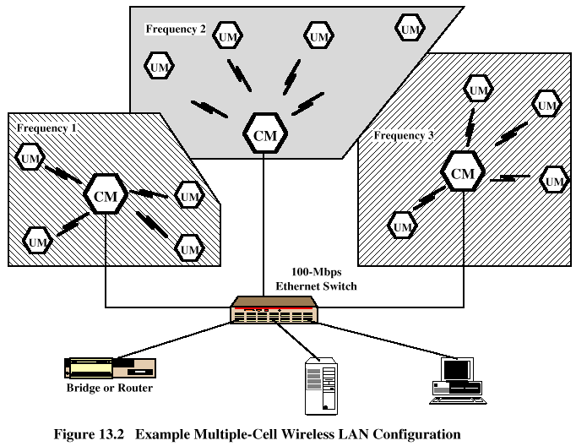
Multiple-cell Wireless LAN

Slide 5
Cross-Building Interconnect
Connect LANs in nearby buildings
  Wired or wireless LANs
Point-to-point wireless link is used
Devices connected are typically bridges or routers

Slide 6
Ad Hoc Networking
Temporary peer-to-peer network set up to meet immediate need
Example:
  Group of employees with laptops convene for a meeting; employees link computers in a temporary network for duration of meeting

Slide 7
Wireless LAN Requirements
Throughput
Number of nodes
Connection to backbone LAN
Service area
Battery power consumption
Transmission robustness and security
License-free operation
Handoff/roaming

Slide 8
Narrowband Microwave LANs
Use of a microwave radio frequency band for signal transmission
Relatively narrow bandwidth
Licensed
Unlicensed

Slide 9
Licensed Narrowband RF
Licensed within specific geographic areas to avoid potential interference
Motorola - 600 licenses in 18-GHz range
  Covers all metropolitan areas
  Can assure that independent LANs in nearby locations don’t interfere
  Encrypted transmissions prevent eavesdropping

Slide 10
Unlicensed Narrowband RF
RadioLAN introduced narrowband wireless LAN in 1995
  Uses unlicensed ISM spectrum
  Used at low power (0.5 watts or less)
  Operates at 10 Mbps in the 5.8-GHz band
  Range = 50 m to 100 m

